Slide 1
4° Básico Clase 1 Inglés

Slide 2
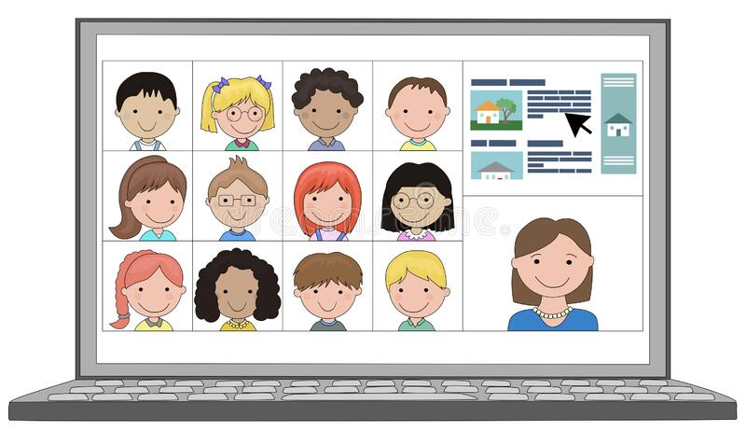
Online Classes

Slide 3
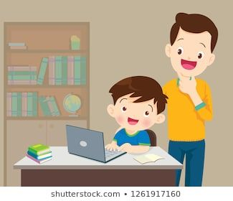
WE ARE ONLINE

Slide 4
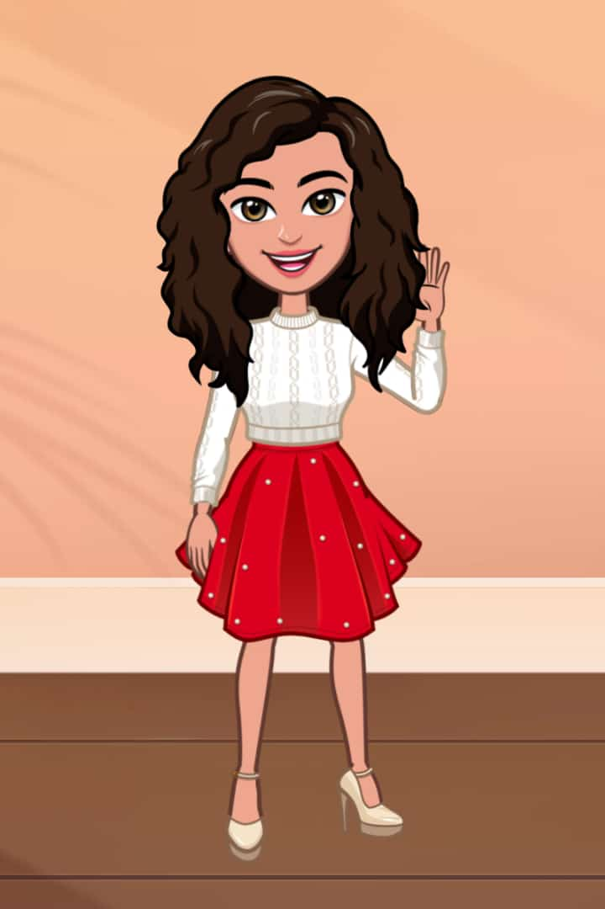
Miss: Cecilia Alzamora M.
cecilia.alzmaterdolorosa@gmail.com
Cuarto Básico A
Link Prueba Diagnóstico:
https://forms.gle/M2gDHGUGJjEN4a799

Slide 5
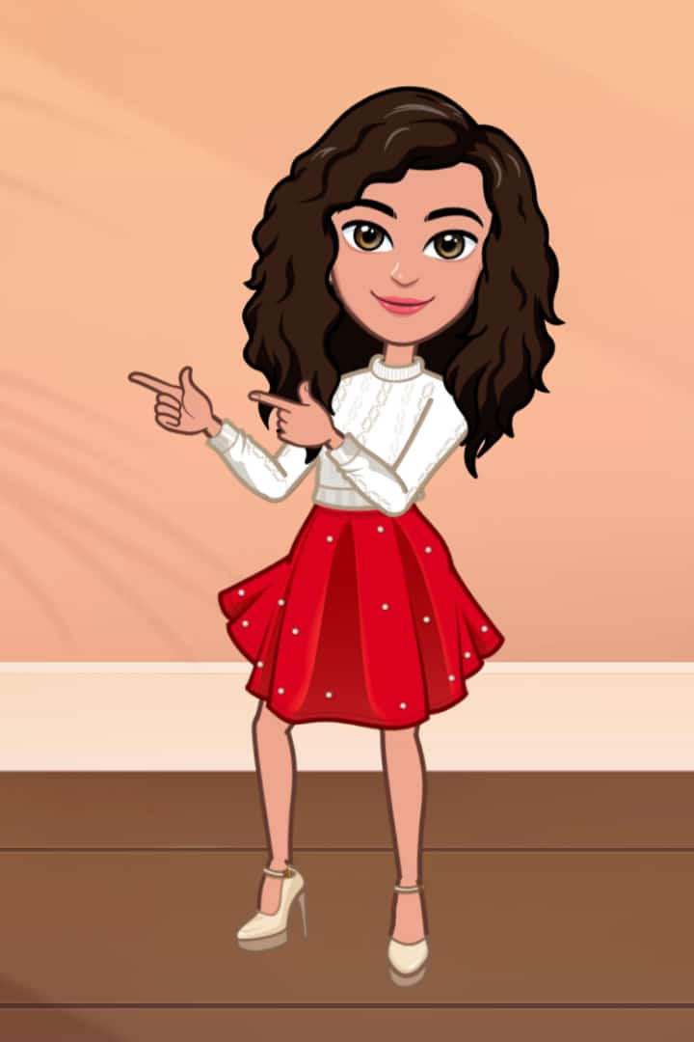
Let’s review contents

Slide 6
School Things

Slide 7
Talking Flashcards

Slide 8
book

Slide 9
copybook

Slide 10
Sharpener

Slide 11
pen

Slide 12
pencil

Slide 13
pencilcase

Slide 14
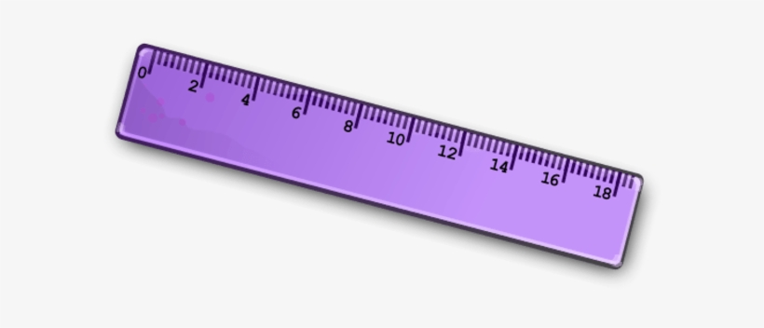
ruler

Slide 15
rubber
eraser

Slide 16
scissors

Slide 17
schoolbag

Slide 18
desk

Slide 19
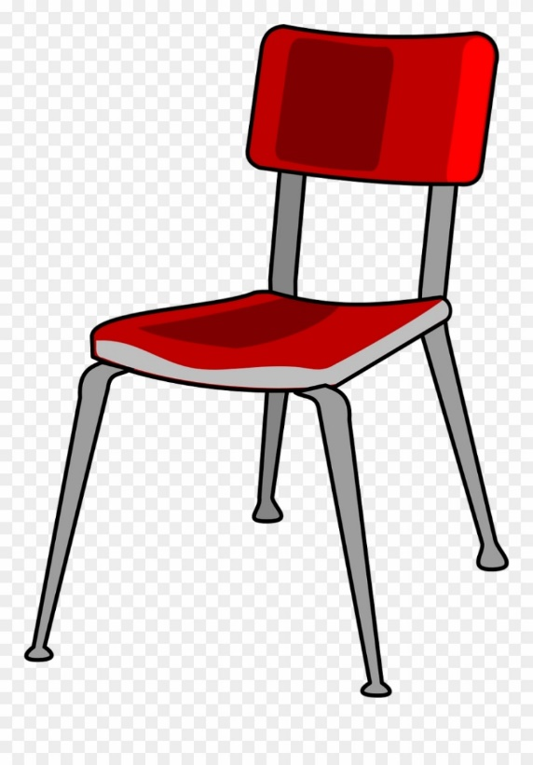
chair

Slide 20
Review School Things Vocabulary
Book Schoolbag
Copybook Desk
Sharpener Chair
Pen
Pencil
Pencilcase
Ruler
Rubber (eraser)
Scissors

Slide 21
What do you think we are going to talk about?

Slide 22
Pay Attention

Slide 23
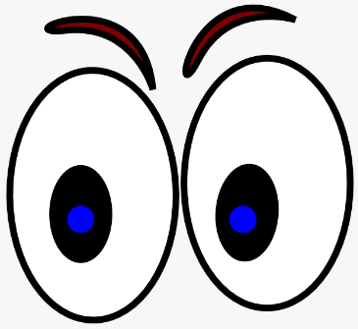
Look

Slide 24
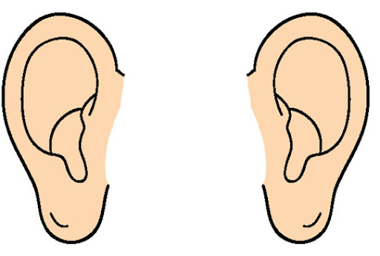
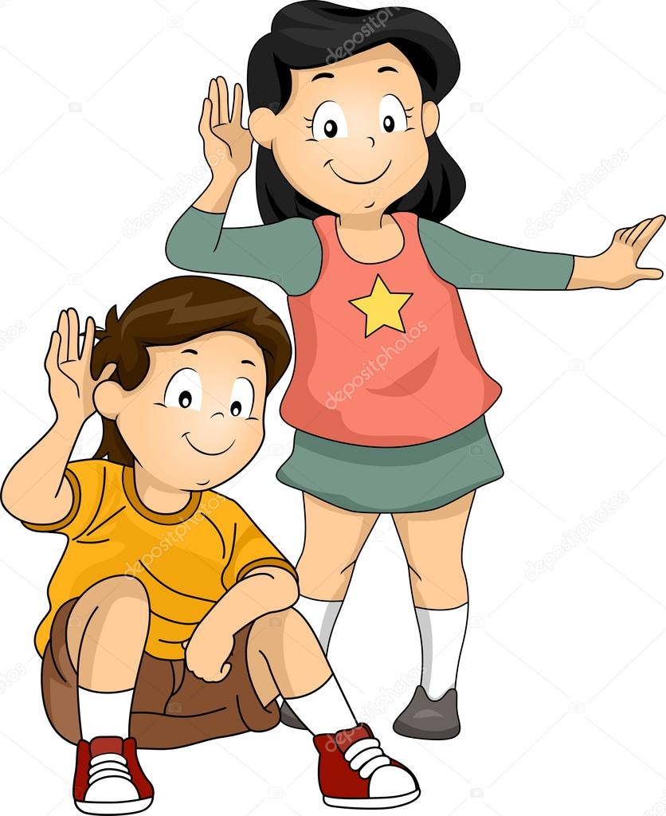
Listen

Slide 25
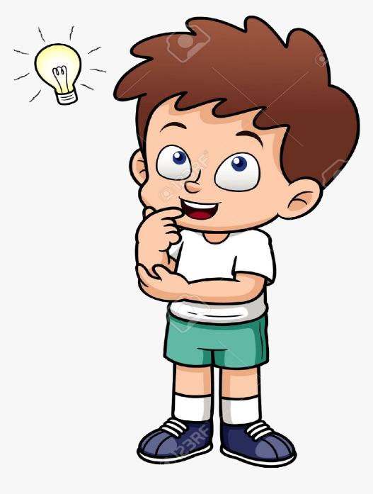
Think

Slide 26
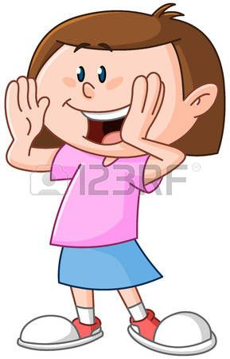
Say

Slide 27
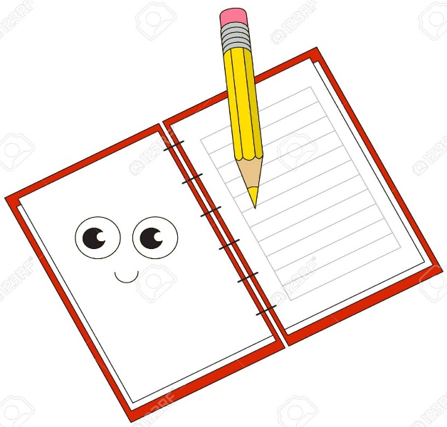
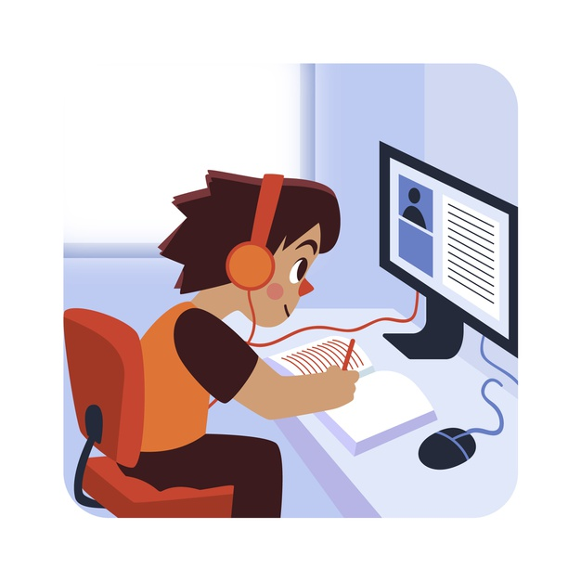
Write, Copy

Slide 28
Flashcards Clothes

Slide 29
What is this?
skirt

Slide 30
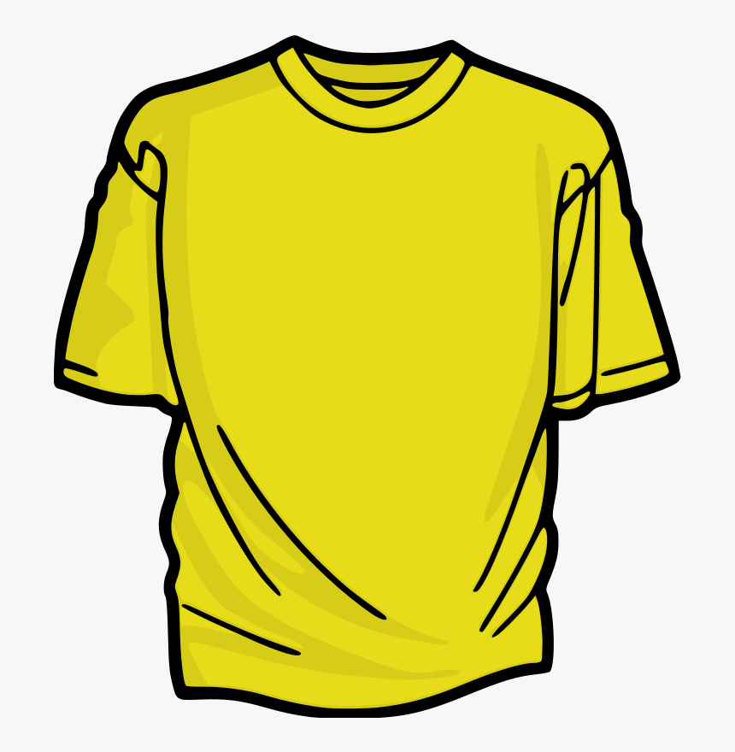
What is this? What color is it?
It’s a yellow T-shirt

Slide 31
What is this? What color is it?
It’s a purple hat

Slide 32
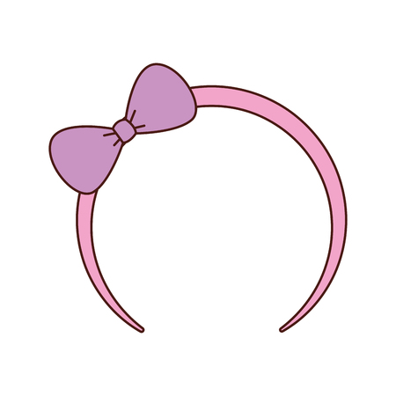
What is this? What color is it?
It’s a red headband

Slide 33
What is this? What color is it?
It’s a tie

Slide 34
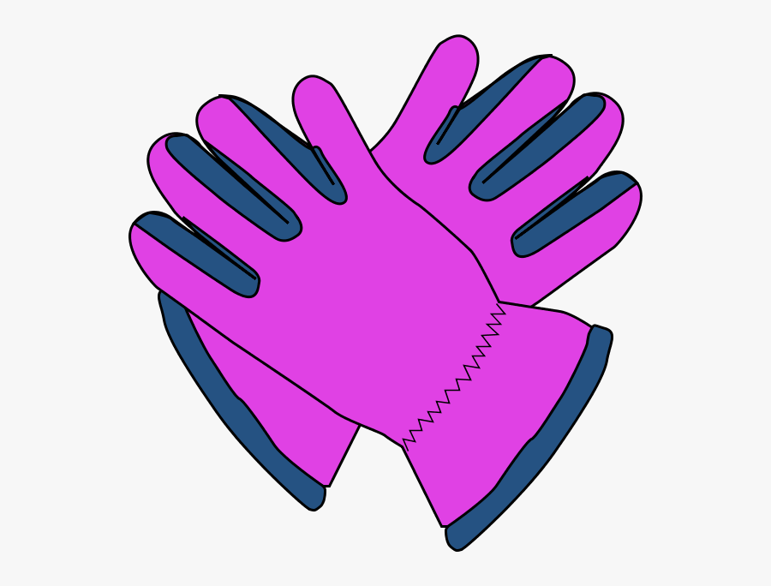
What are these? What color are they?
Gloves

Slide 35
What is this? What color is it?
It’s a scarf

Slide 36
Now look, listen and say

Slide 38
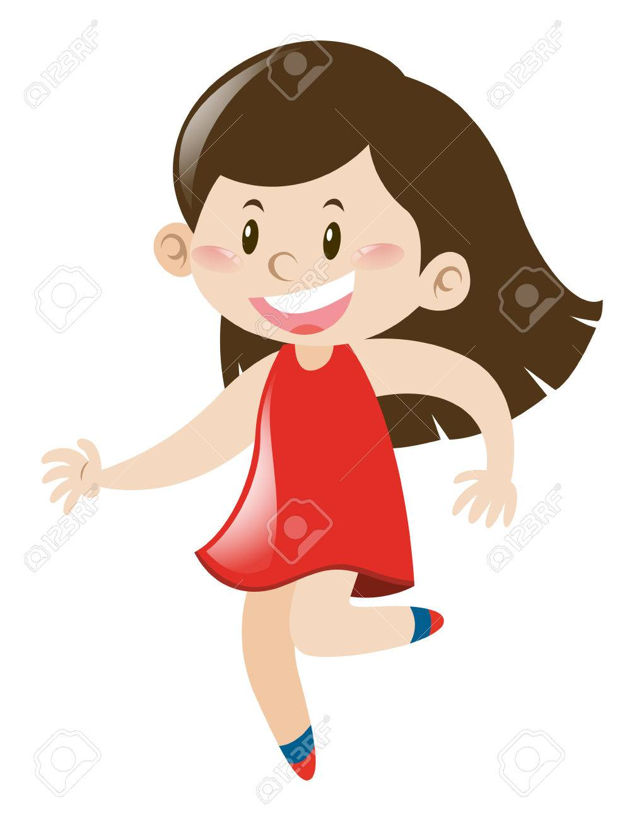
What is she wearing?
She is wearing a red dress.

Slide 39
What is he wearing?
He is wearing a green sweater,
blue jeans and a light blue hat.

Slide 40
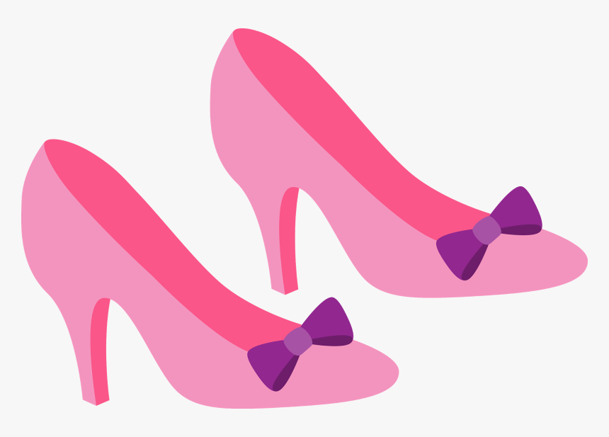
What are these? What color are they?
They are pink shoes

Slide 41
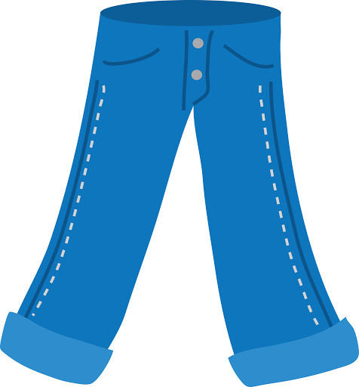
What are these? What color are they?
They are blue jeans

Slide 42
What are these? What color are they?
They are purple shorts

Slide 43
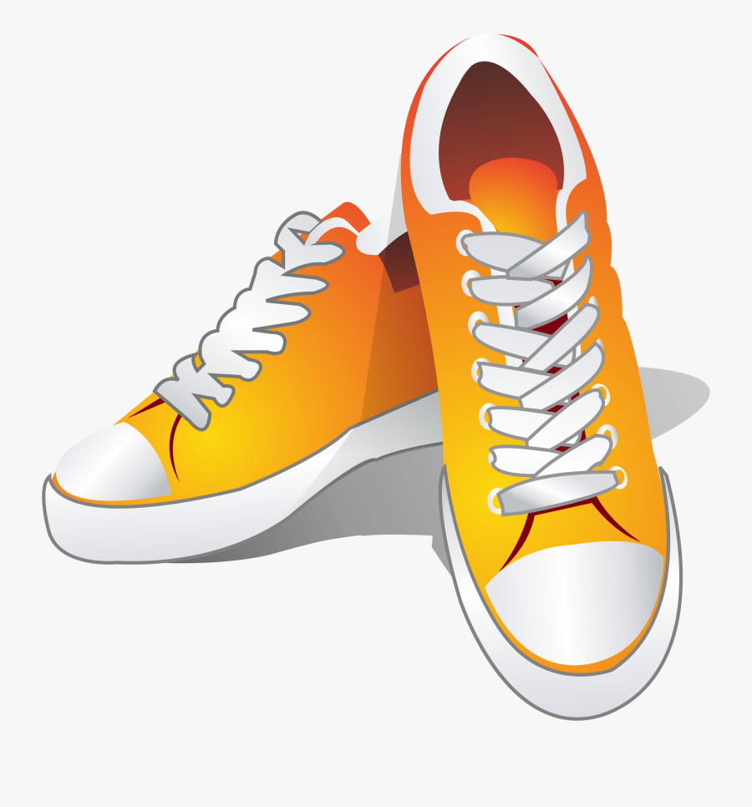
They are yellow trainers

Slide 44
They are red boots

Slide 45
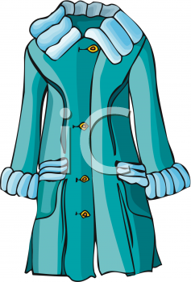
It’s a light
blue coat

Slide 46
It’s a green sweater

Slide 47
It’s a blue cap

Slide 48
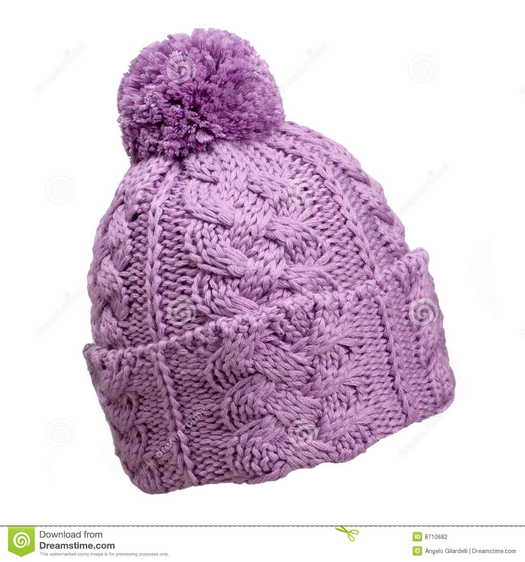
It’s a woolen pink hat

Slide 49
Now you describe what they are wearing

Slide 50
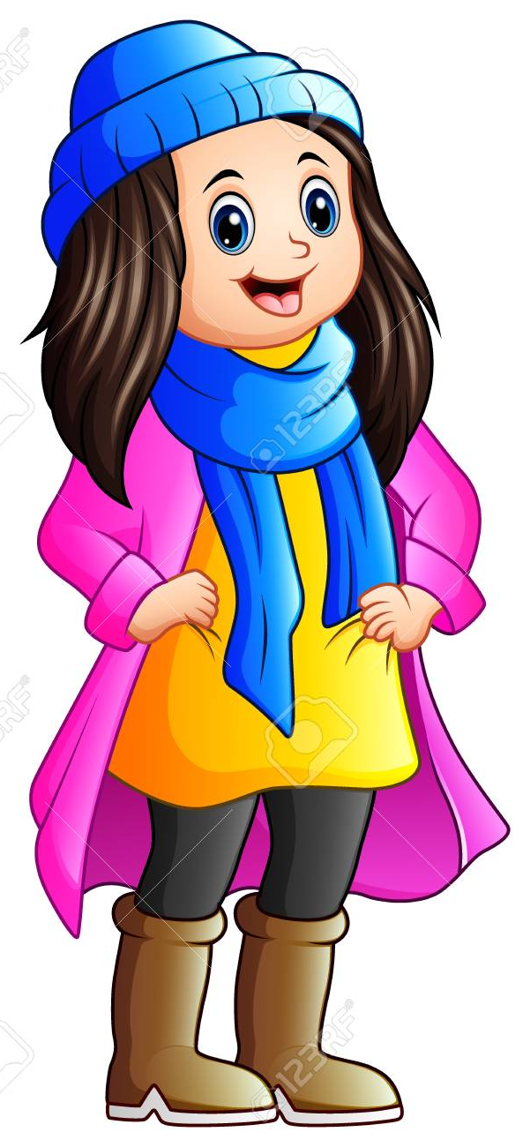
Example:
She’s wearing
a blue hat and a blue scarf,
a pink coat, and a yellow sweater,
black pants and brown boots.

Slide 51
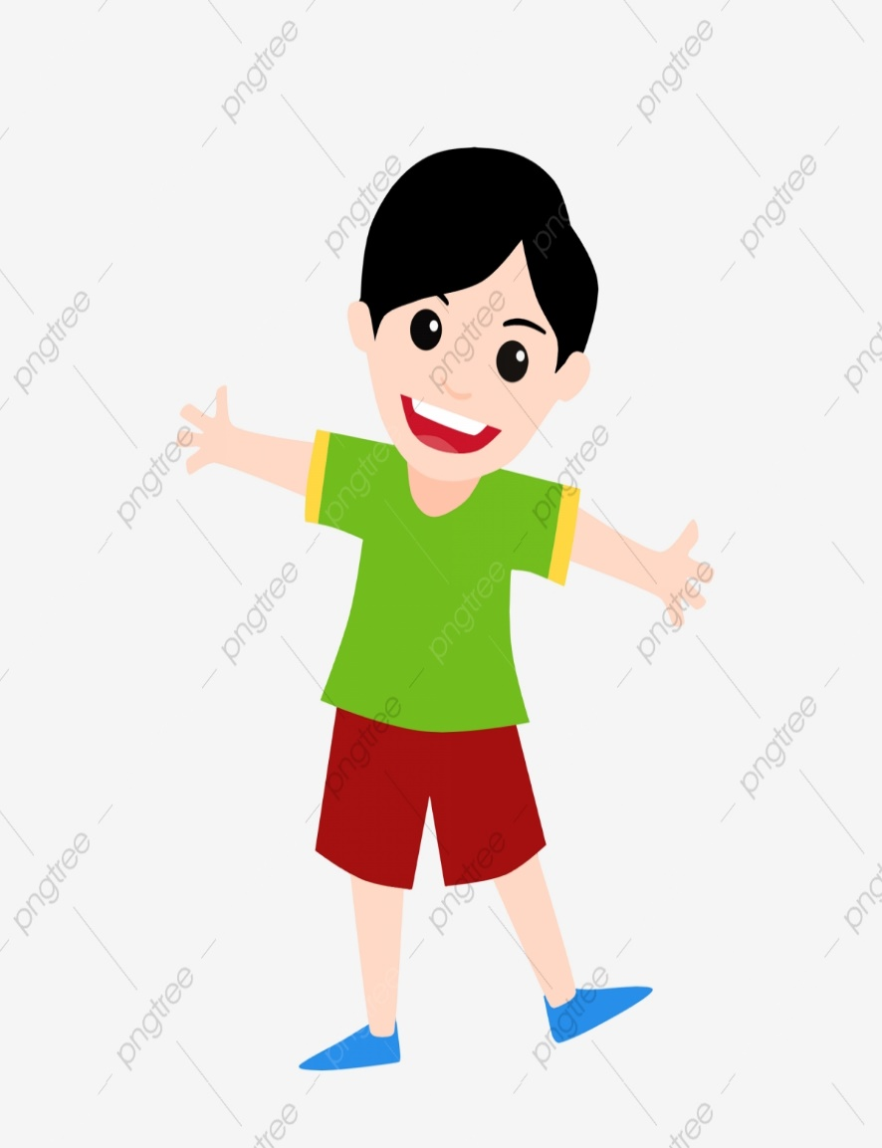
He is wearing
a green T shirt,
red shorts
and blue shoes

Slide 52
Describe:
Look, read, think and write
She’s wearing…………
………………………………
………………………………
………………………………
……………………………...

Slide 53
The End

