Slide 1
Diagnostic test revision.
Learning objective:
To revise the diagnostic test collectively.

Slide 2
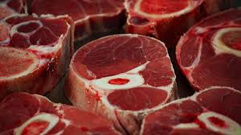
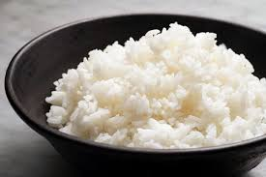
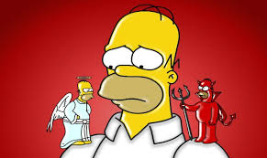
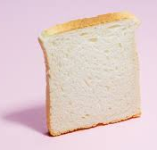
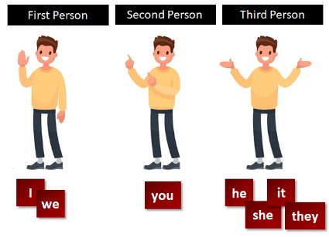
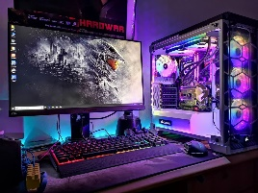
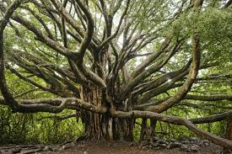
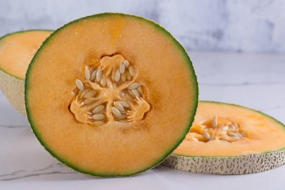
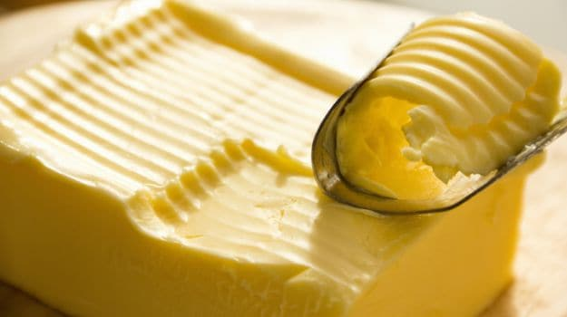
COUNTABLE NOUNS
UNCOUNTABLE NOUNS

Slide 3
𝐐𝐮𝐚𝐧𝐭𝐢𝐟𝐢𝐞𝐫𝐬. Choose the correct option for each sentence.

Slide 16
Reading comprehension.
I’ m Tim Black. I’m a doctor. I work at a hospital. My wife, Kim, is a teacher. She teaches Music at a college. We get up at seven o’clock every morning. Kim sets the table, and we have breakfast. Kim likes toast and tea, but I don’t. I eat an egg and I drink milk at breakfast. Then, we leave home at a quarter past eight. I start to work at nine o’clock. I am very busy, so I can’t have a break. At half past twelve, I have lunch at the hospital cafeteria. The food at the cafeteria is very good, so I don’t go out for lunch. Kim returns home at three o’clock in the afternoon, and I come back at five o’clock. Afterwards, we have dinner at half past six. I watch TV in the evenings, but Kim doesn’t. She reads a book or she listens to music. We go to bed early after a tiring day. At weekends we go to the cinema or theatre. My wife and I like shopping, so we usually go on shopping on Saturdays. We have a holiday every August. We often go to Izmir in Turkey for holiday. I ride a bike and Kim walks around, because she doesn’t know how to ride a bike. We like Izmir very much, so we go to there every summer.

Slide 17
True or False.
Tim is Kim’s husband.
Kim and Tim get up at nine o’clock.
Tim’s wife sets the table in the mornings.
They always have a holiday in Ýzmir every summer.
They don’t like cinema.
Kim works at a college.
Dr. Black goes to a restaurant for lunch.
Kim comes back home at five o’clock.
Mrs Black goes on shopping with her husband.
They leave home at a qurter to eight in the mornings.

