Slide 1
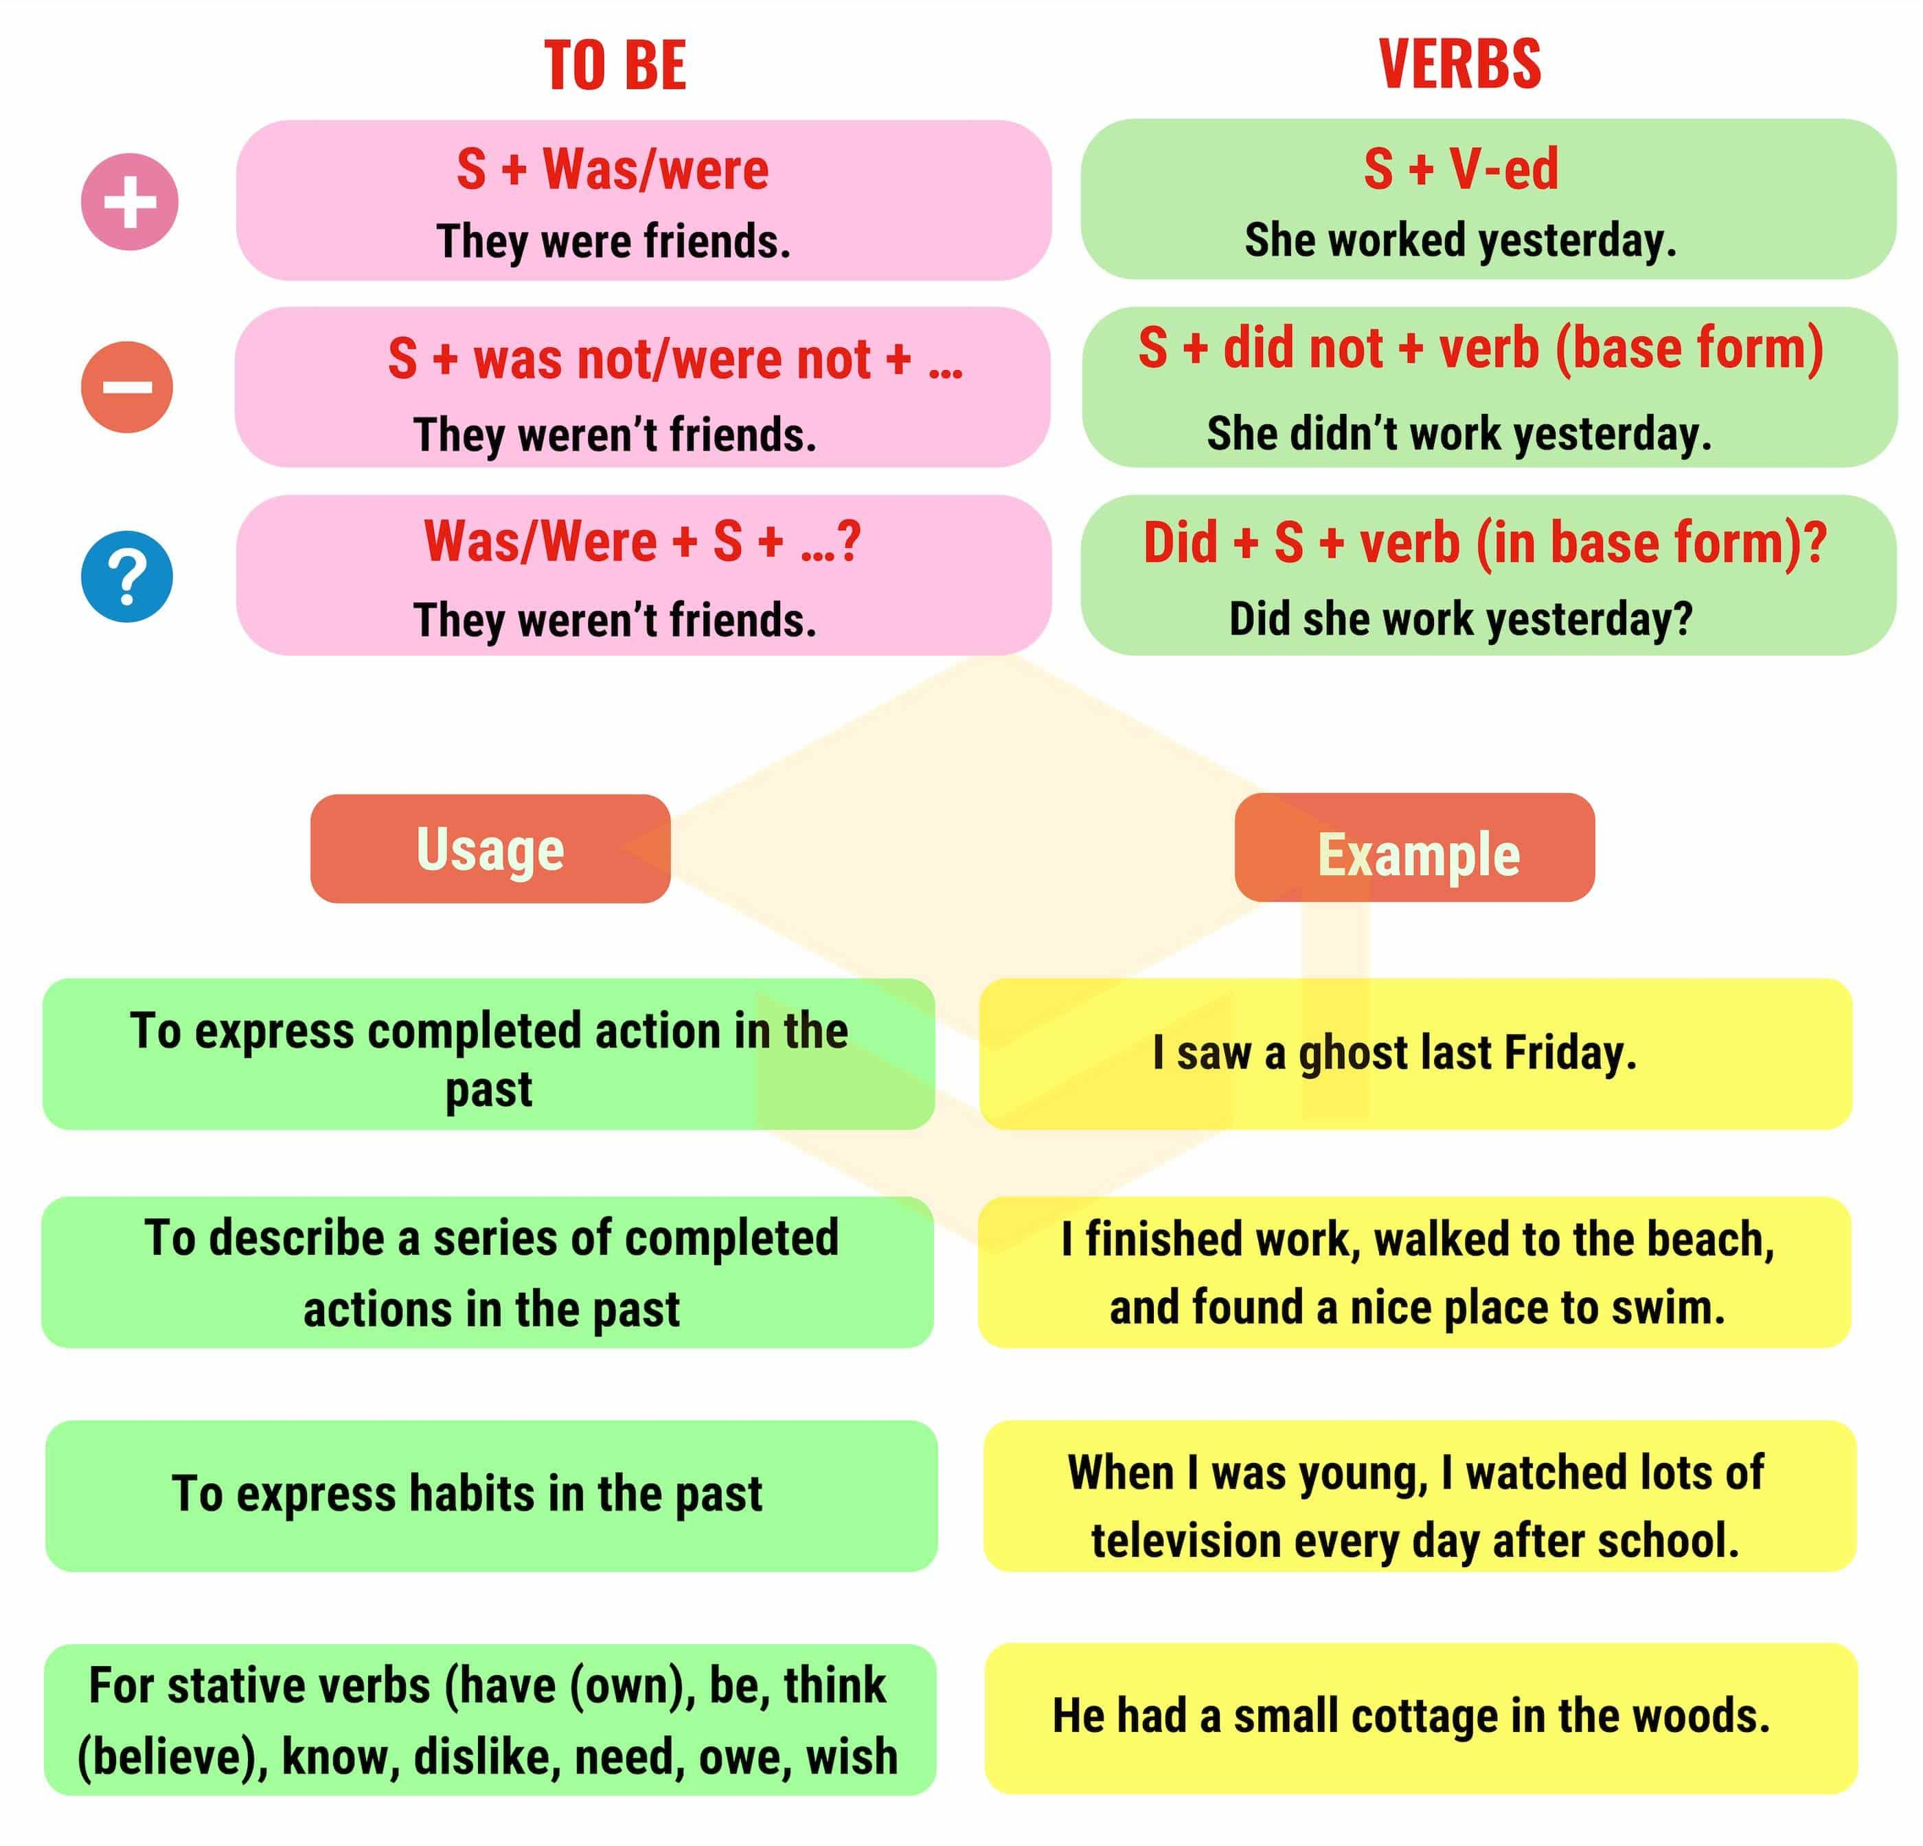
Simple Past

Slide 3
Write the Past Simple form of the verbs below in the correct column
( repeat – worry – finish – start – phone – call – miss – enjoy – visit – marry – listen – cry – play – hate – wash – climb – live – arrive – talk – look – stay – ask – clean – travel – open – like – walk – carry – stop – mix – plan – decide – tidy )
-d | -ed | cons + y -ied | double cons + -ed
phoned hated lived arrived decided | repeated finished started called missed enjoyed visited listened played washed climbed talked looked stayed asked cleaned opened walked mixed | worried married cried carried tidied | travelled stopped planned

Slide 4
Make the past simple, positive, negative or question.
I didn’t drink (not / drink) any beer last night.
She got on (get on) the bus in the centre of the city.
What time did he get up (he / get up) yesterday?
Where did you get off (you / get off) the train?
I didn’t change (not / change) trains at Victoria.
We woke up (wake up) very late.
What did he give (he / give) his mother for Christmas?
I received (receive) £300 when my uncle died (die).
We didn’t use (not / use) the computer last night.
Did she make (she / make) good coffee?
They lived (live) in Paris.
She read (read) the newspaper yesterday.
I did not watch (not / watch) TV.
He did not study (not / study) for the exam.
Did he call (he / call) you?
Did I forget (I / forget) something?
What time did the film (the film / start)?
He had (have) a shower.
Why did you come (you / come)?
Did he go (he / go) to the party?

Slide 5
Complete the story using the words in brackets.
Benjamin Franklin …… was born ….. (be born) in Boston in 1706. He was (be) the fifteenth of the seventeen children of a poor candlemaker. He went (go) to school only one year. He began (begin) to work when he was twelve. At the age of fourteen he decided (decide) to be a writer. He copied (copy) the great stories of famous writers and later he became (become) the best known writer in his time. When he was (be) seventeen, he left (leave) Boston and arrived (arrive) in Philadelphia with only a few pennies in his pocket. He got (get) a job as a publisher of a newspaper and retired (retire) from business as a very rich man at forty-two. Then he spent (spend) the next forty years for his government. He played (play) an important role in the founding of the USA. Franklin was (be) also an important scientist and inventor. He drew (draw) electricity from a cloud on a kite string. He wrote (write) one of the first text books on electricity. He invented (invent) a simple lightning rod and many other practical tools. He made (make) a study of water.

