Slide 1
Welcome back!

Slide 2
Write the correct form of the verbs in brackets.
She plays (play) the violin.
Are we (we / be) in the right place?
Is she (she / be) from China?
You are not (not / be) from Argentina.
I don’t need (not / need) any help.
Am I (I / be) correct?
It is (be) cold outside.
He doesn’t study (not / study) German.
We are (be) in the kitchen.
I ‘m not (not / be) thirty.
You want (want) a new car.
She isn’t (not / be) a teacher.

Slide 3
Read the paragraph and answer the questions.
Brian is a doctor. He looks after sick people. He usually gets up at 6.00 o’clock. Today he is late, it is 6.30 and he is still in bed. He usually goes to work by train but today he is driving to work. He arrives at work at 6.30 every morning but it is 7.30 now and he is still driving. It’s 12.00 o’clock now. He always has his lunch at 12.00 but today he isn’t having lunch at 12.00, he is looking after his sick patients. It is half past seven now, Brian is watching TV. He usually watches TV at half past seven because his favorite programme starts at half past seven. Brian has his dinner at 8.30 everyday and he is having dinner now. It is 12.00 now Brian is going to bed. He always goes to bed at 12.00.

Slide 4
1. What does Brian do? 6. When does he always have his lunch?
He is a doctor. He always has lunch at 12 o’clock.
2. What time does he usually get up? 7. What is he doing at 12.00 today?
He usually gets up at 6 o’clock. He’s looking after his sick patients.
3. How does he usually go to work? 8. Why does he usually watch TV at 7.30?
He usually goes to work by train. Because his favorite programme starts a 7.30
4. Why is he driving to work today? 9. What time does he go to bed?
Because he is late. He goes to bed at 12 o’clock
5. What time does he arrive at work everyday? 10. What time is he going to bed now?
He arrives at work at 6.30 He’s going to bed at 12 o’clock

Slide 5
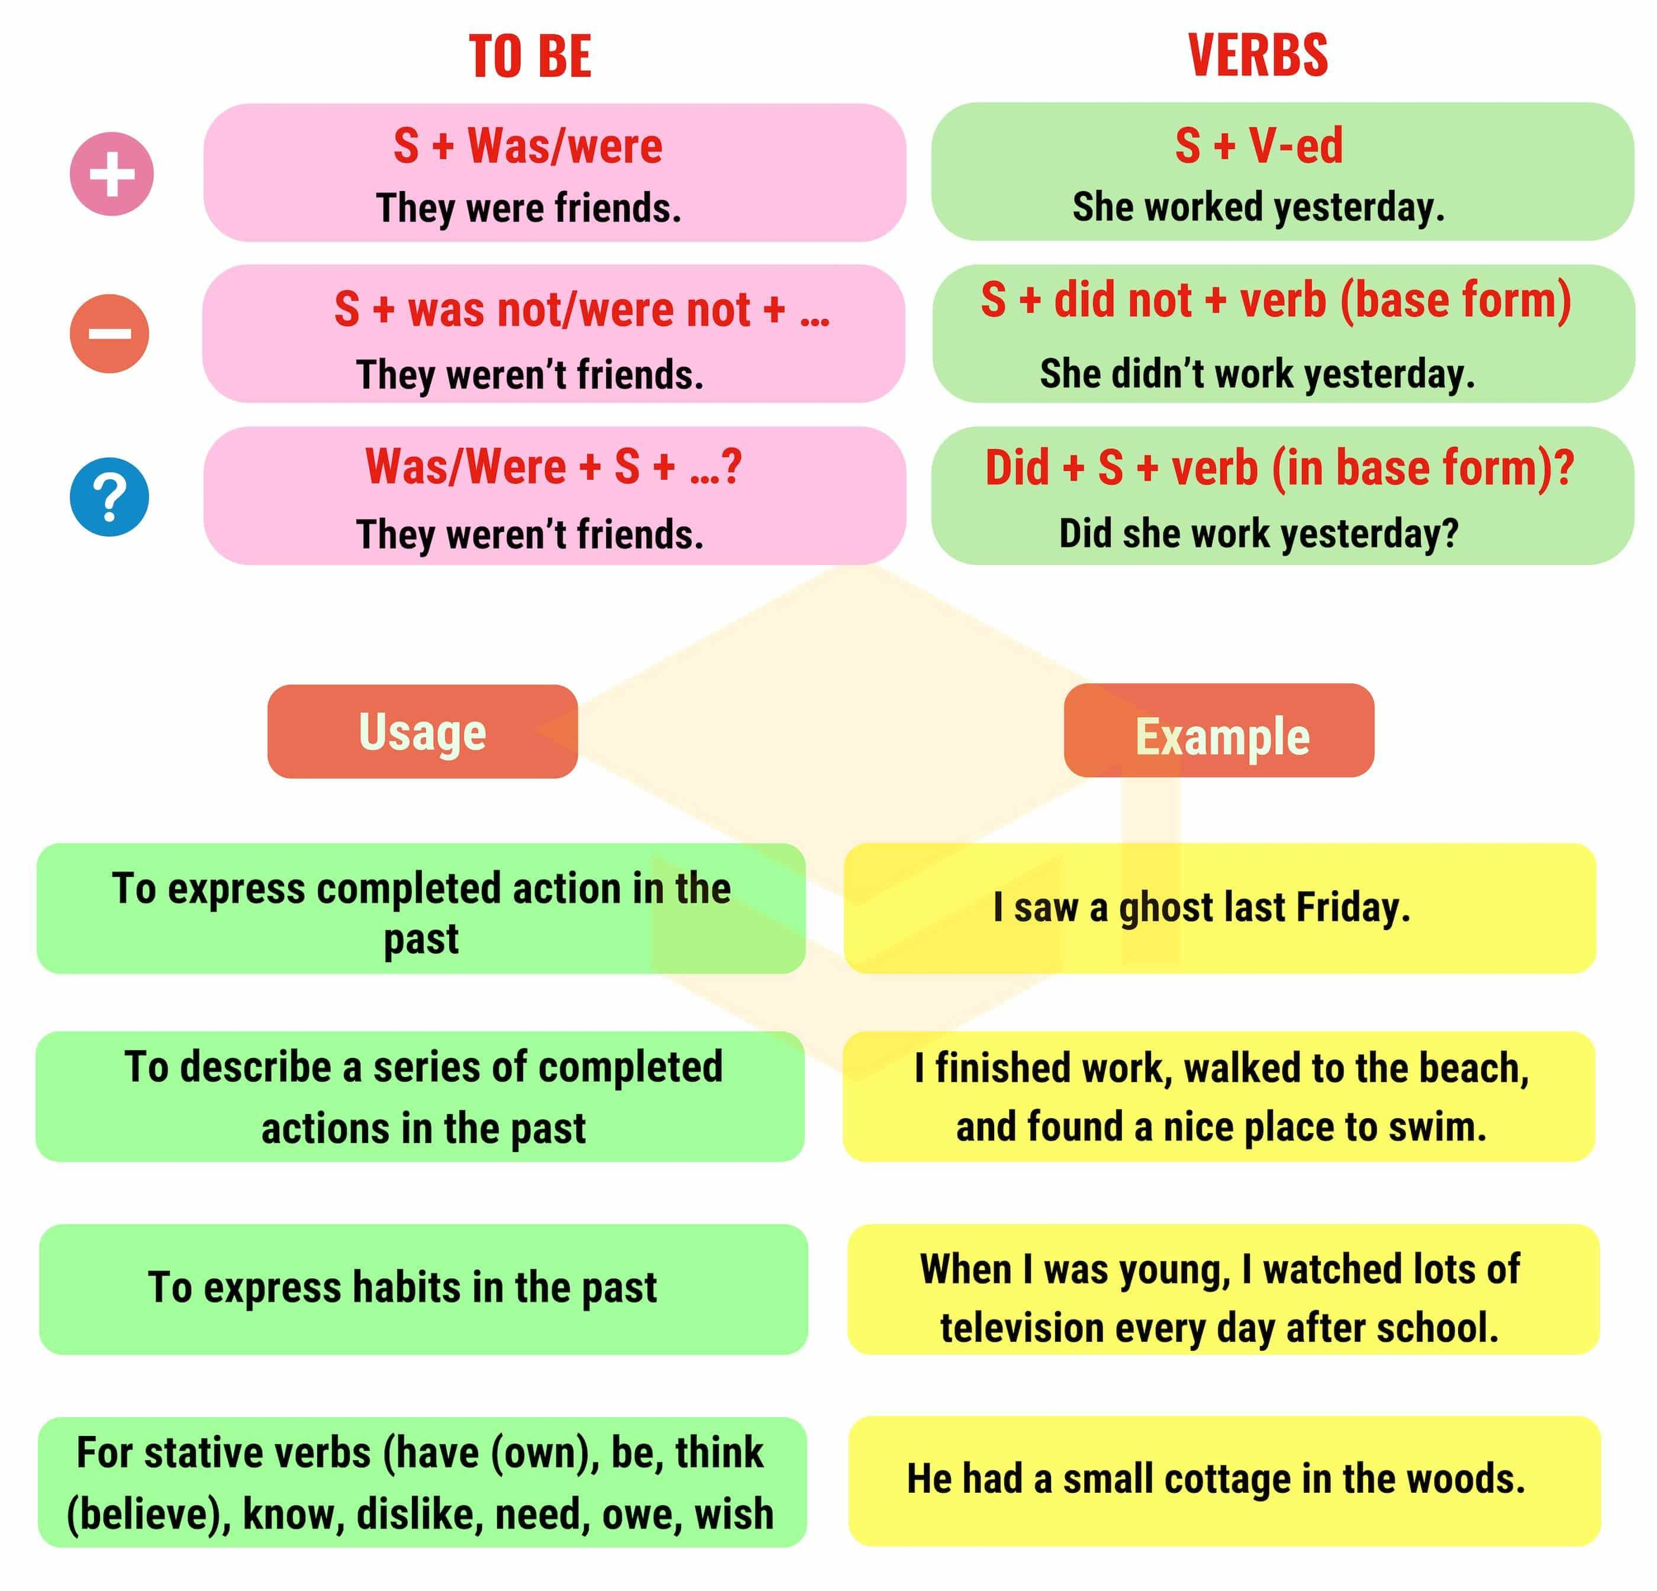
Simple Past

